Slide 1
Matt Ellis Viva
Development and Application of Mixed
Quantum-Classical Non-adiabatic Molecular
Dynamics Techniques for Charge Transport
in Organic Semiconductors

Slide 2
Intro
My work has been concerned with nonadiabatic systems
Used various techniques, mainly Surface hopping and CTMQC to simulate organic systems.
It has been a mix of method development and applications work

Slide 3
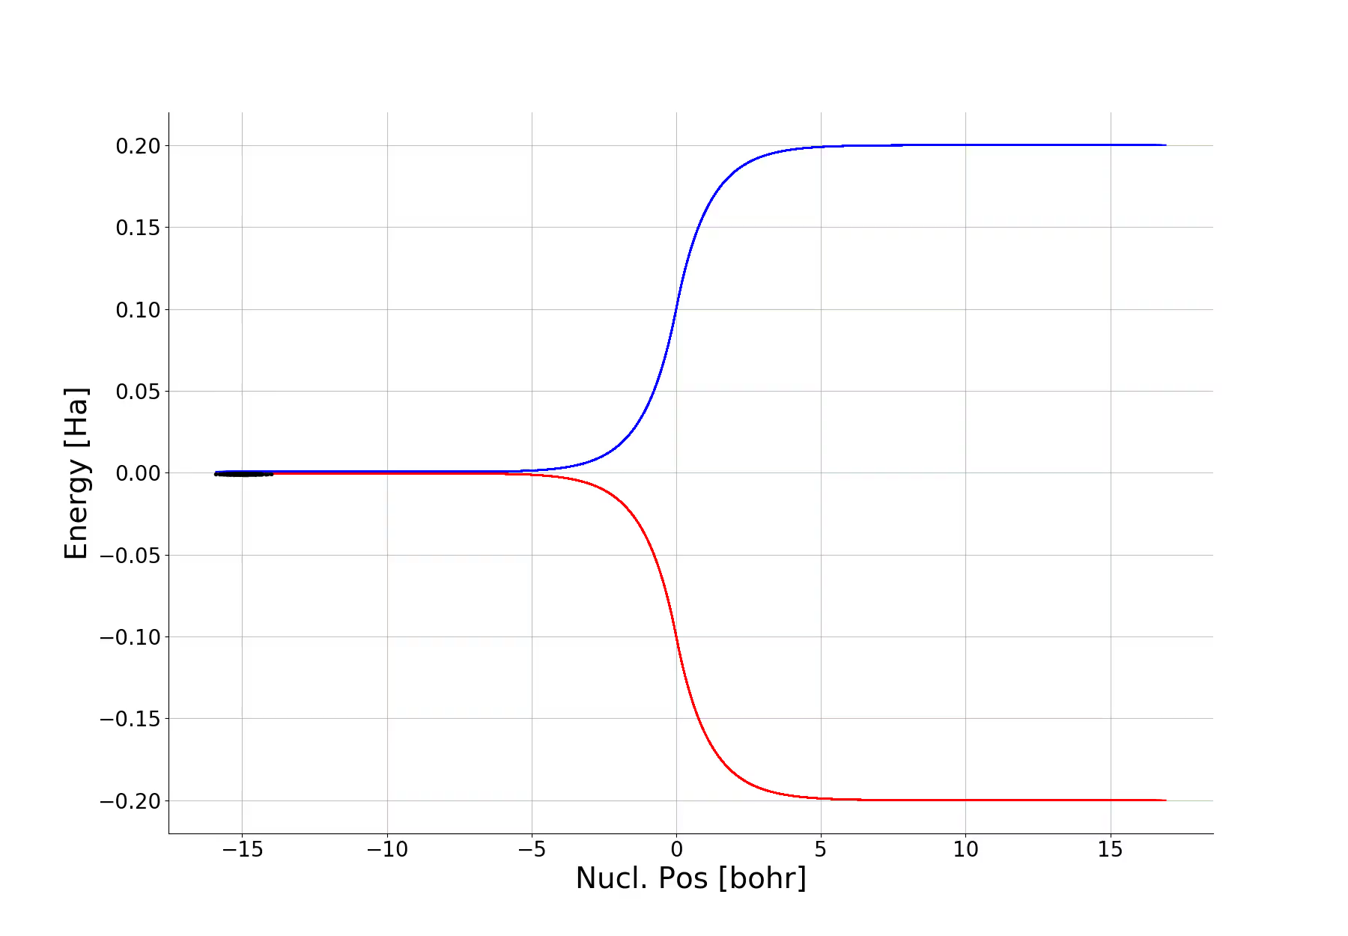
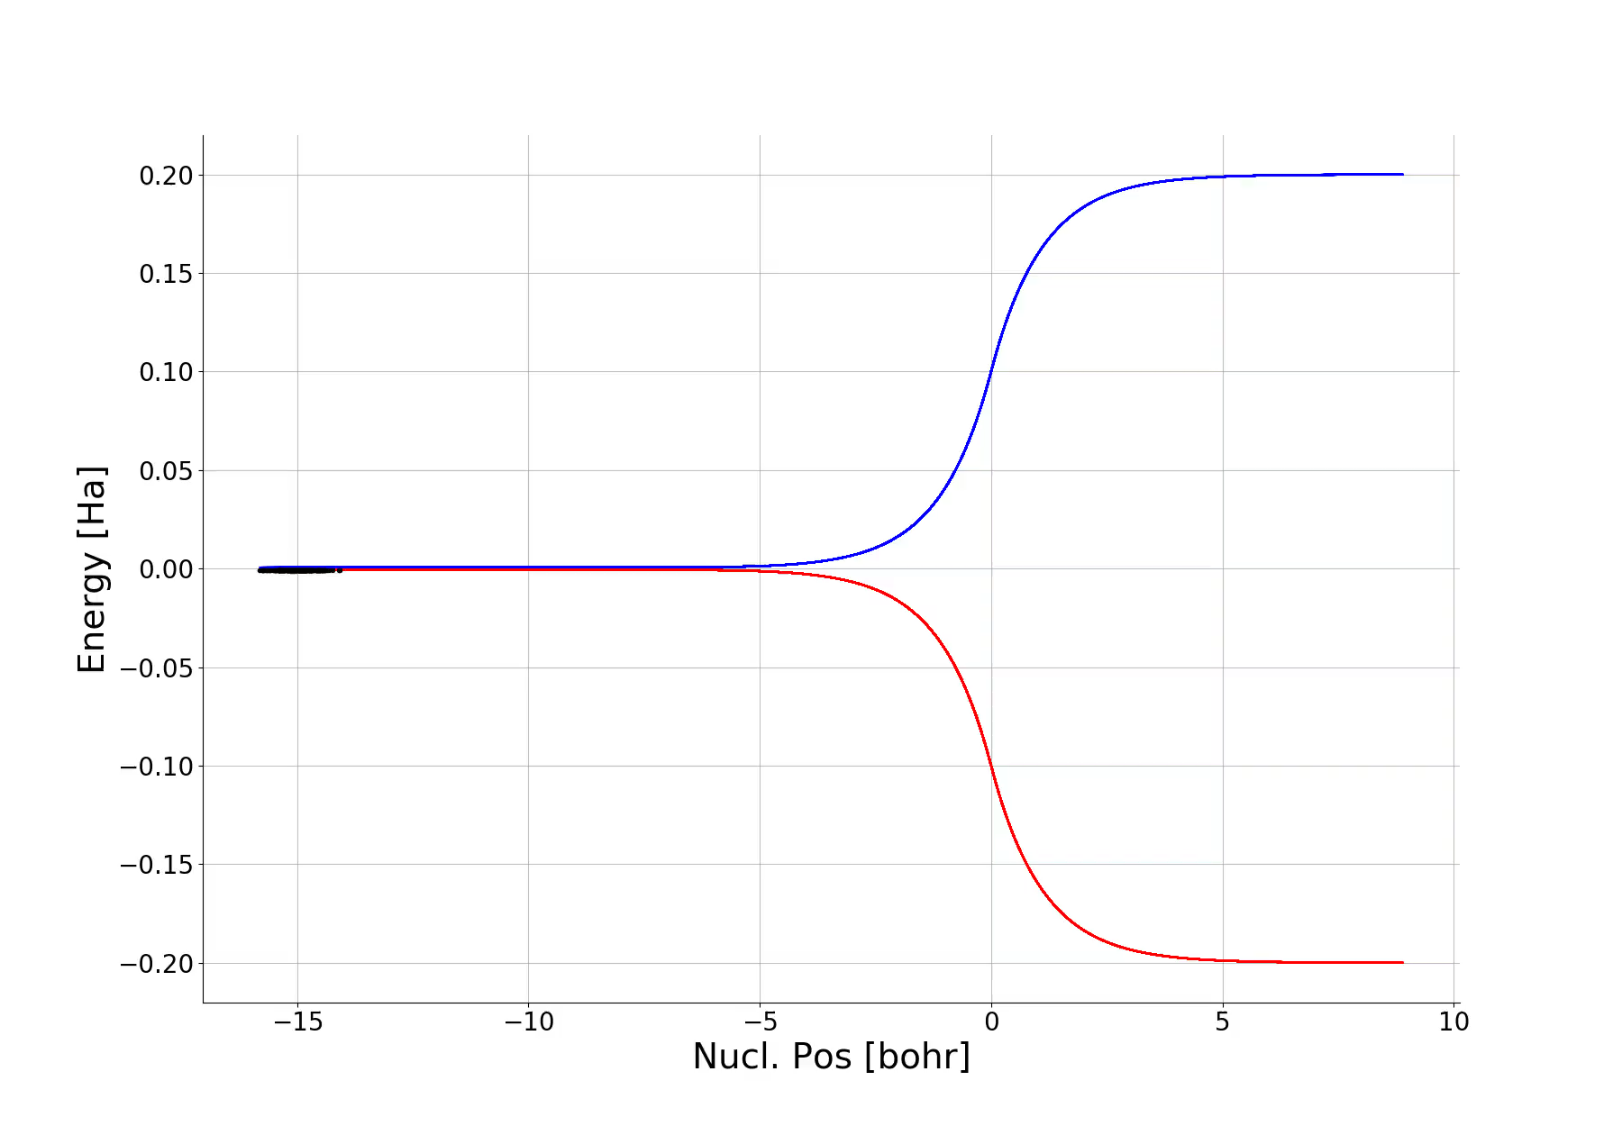
CTMQC
Ehrenfest
Derived from the exact factorisation of the nuclear and electronic wavefunctions.
Made 5 assumptions:
Classical nuclei
Ignoring the ENCO term
Ignore the first term in the derivative of the adiabatic coeffs
Reconstruct the nuclear wavefunc with gaussians.
Separate the effects of NACV and decoherence.
Equations appear as Ehrenfest eqns with a 'correction'.
CTMQC

Slide 4
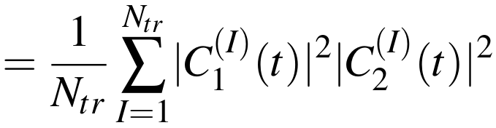
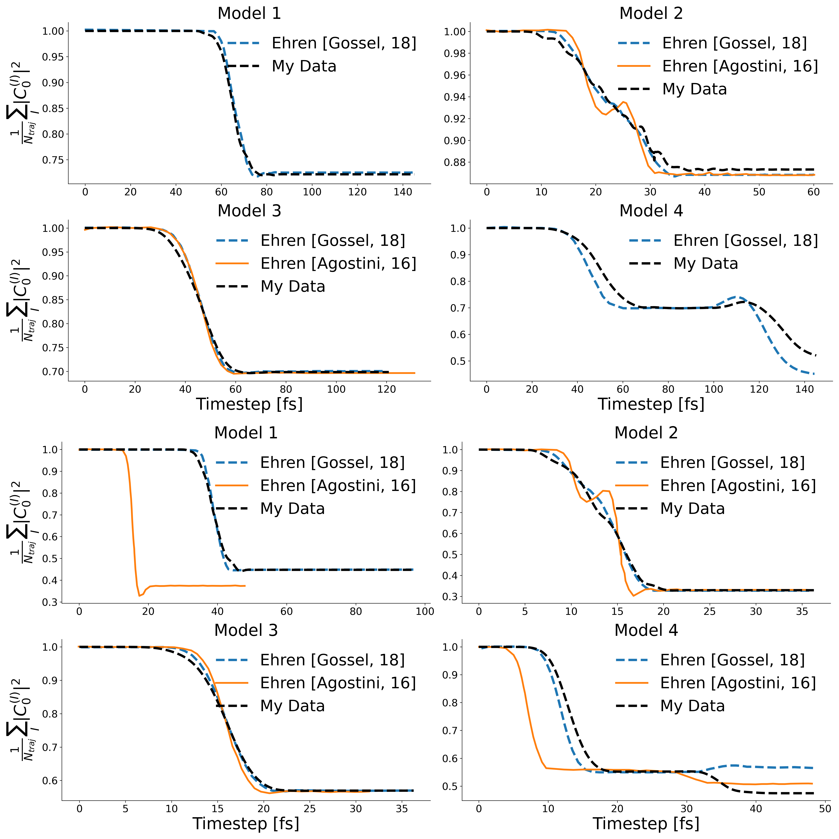
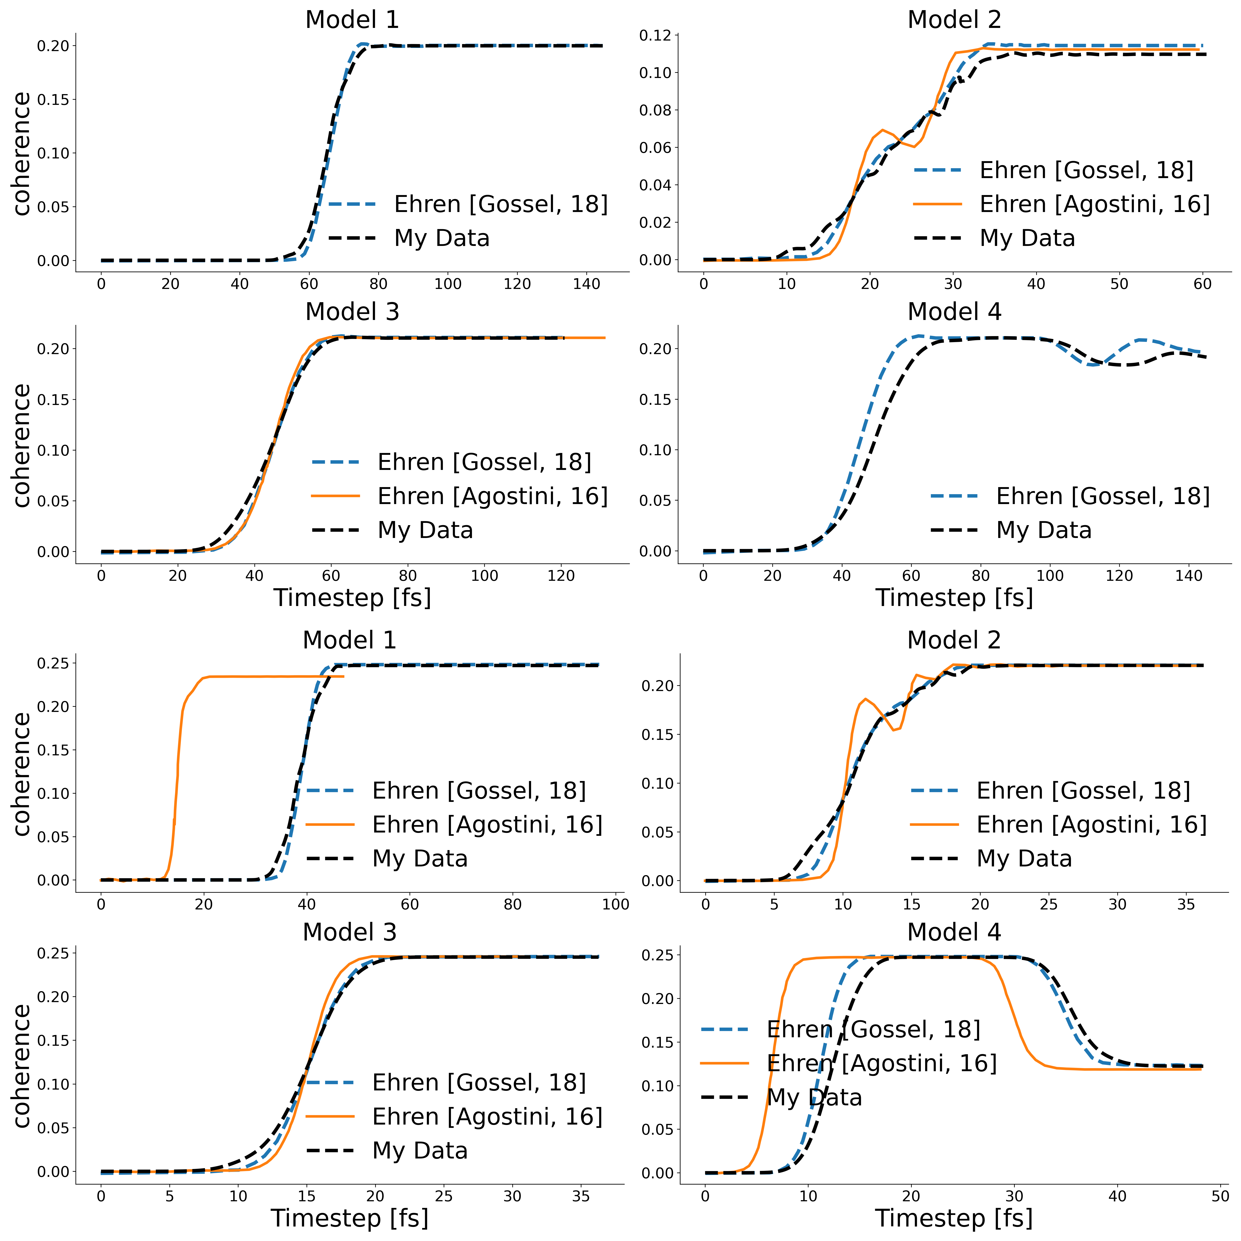
Results -Ehrenfest Implementation
coherence
indicator

Slide 5
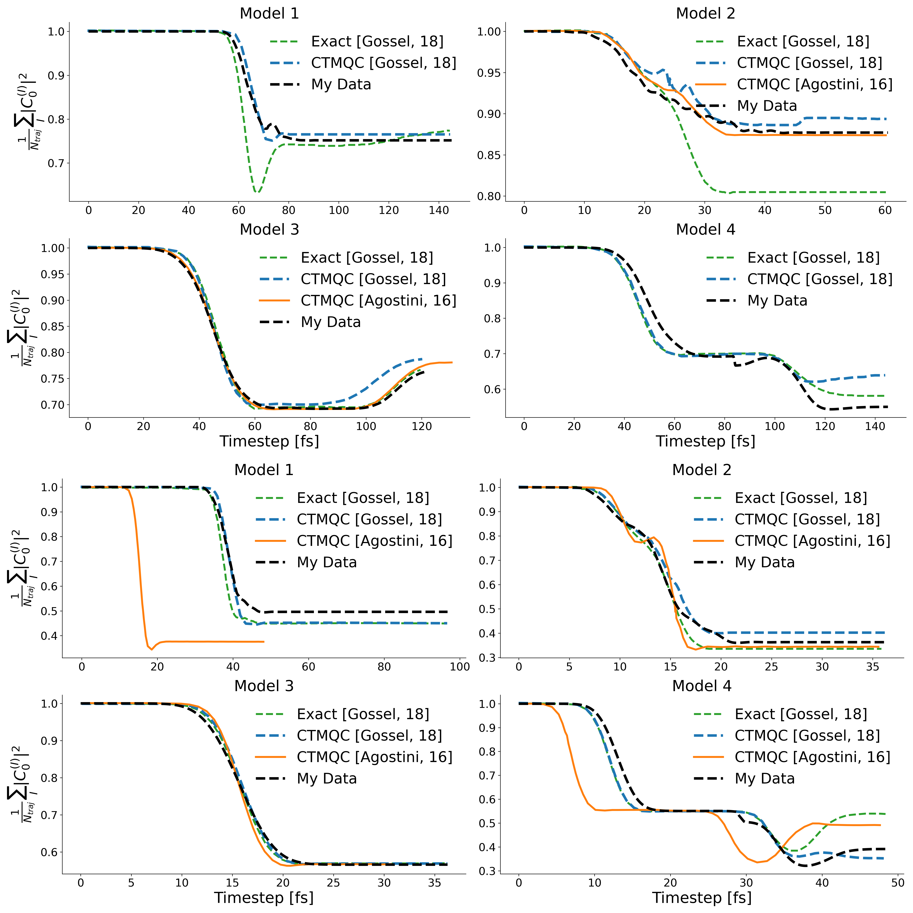
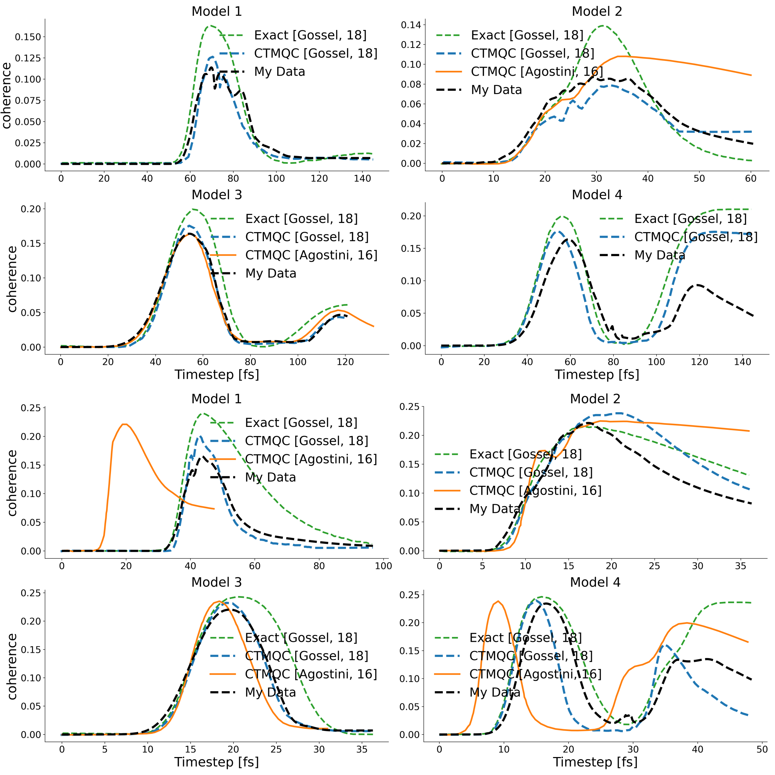
Results -CTMQC Implementation
coherence
indicator

Slide 6
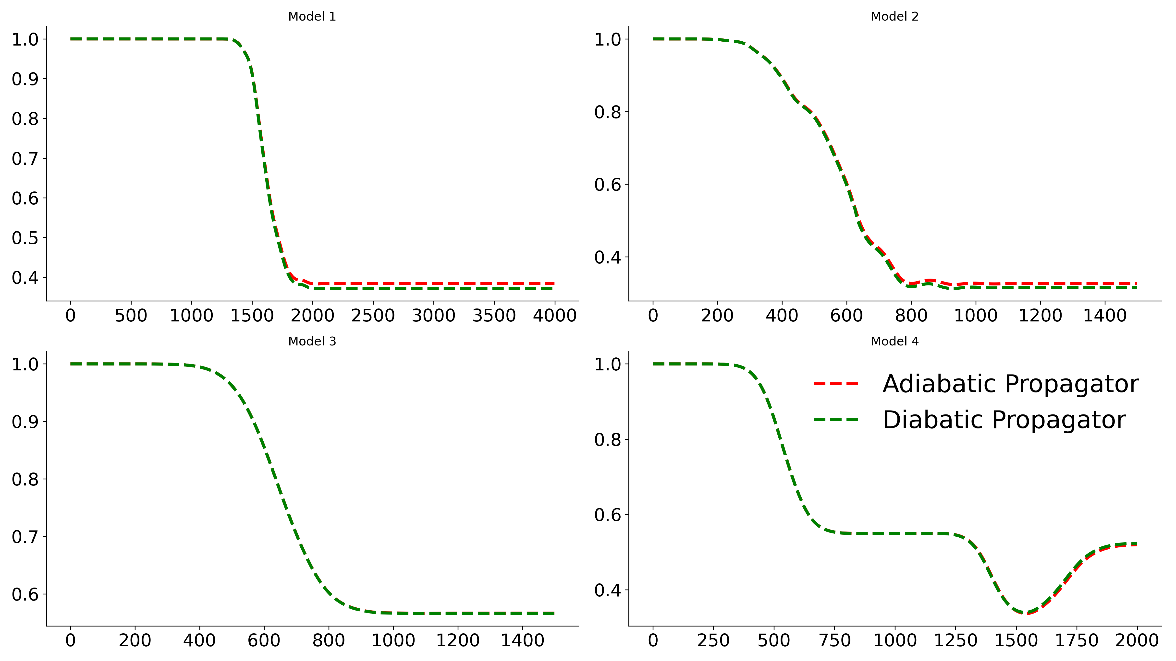
Further CTMQC Development
Transformed to diabatic basis and applied to molecular systems.
Couldn't use to
simulate dimers as
the algorithm was
too unstable.

Slide 7
Problems with CTMQC
Bad energy conservation
Unstable propagation due to divergences of one of the terms.
Need to parameterise.
Requires small timesteps to conserve norm.

Slide 8
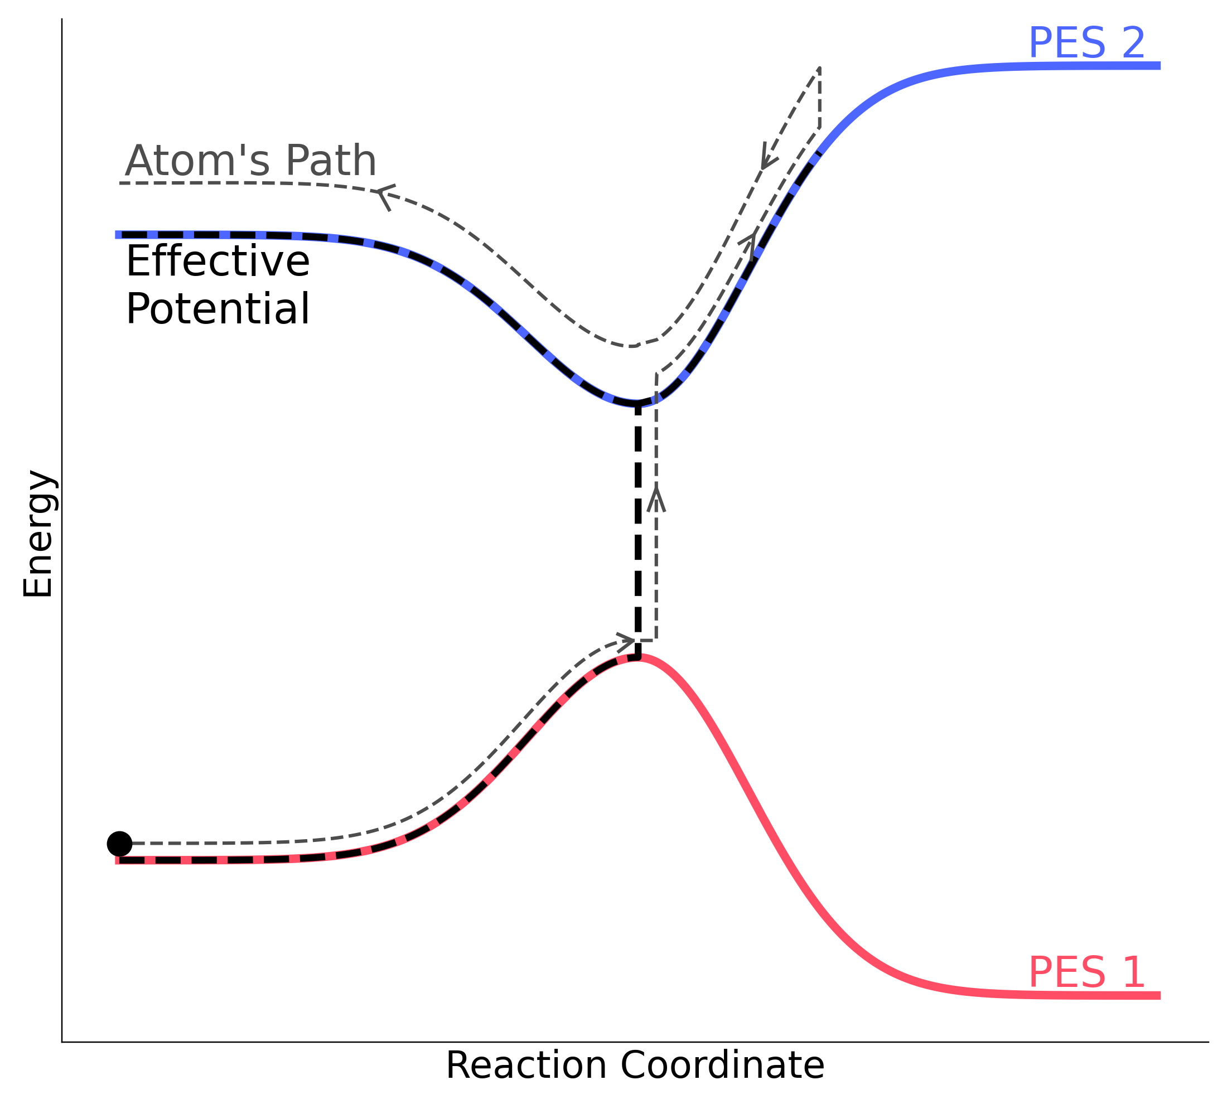
Alternative to CTMQC -Surface Hopping
Well tested / already implemented
Stable
Fast

Slide 9
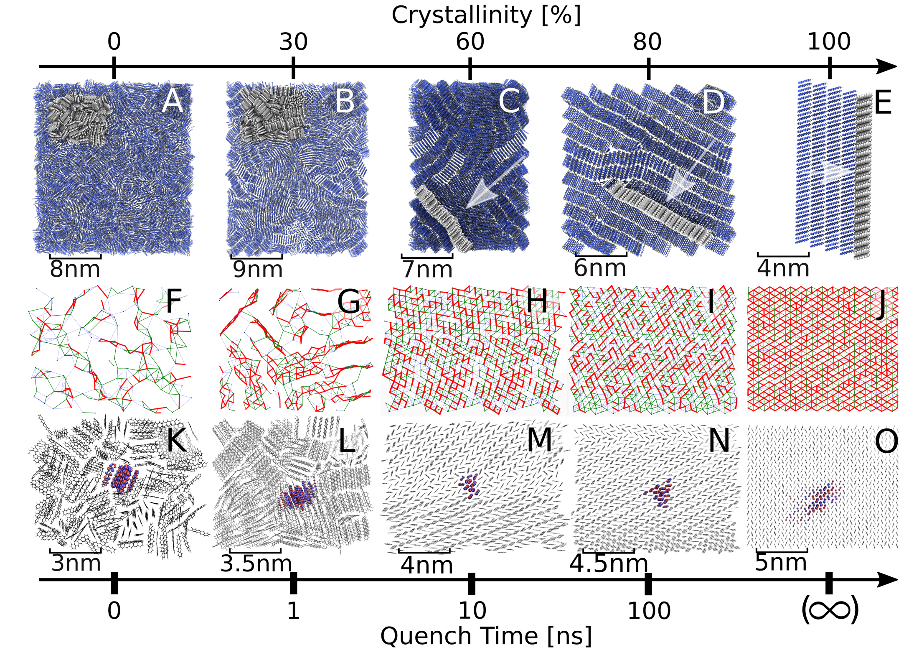
Surface Hopping Application Amorphous systems
Used a melt-quench scheme to create systems of varying levels of crystallinity.
Ran surface hopping on each one.

Slide 10
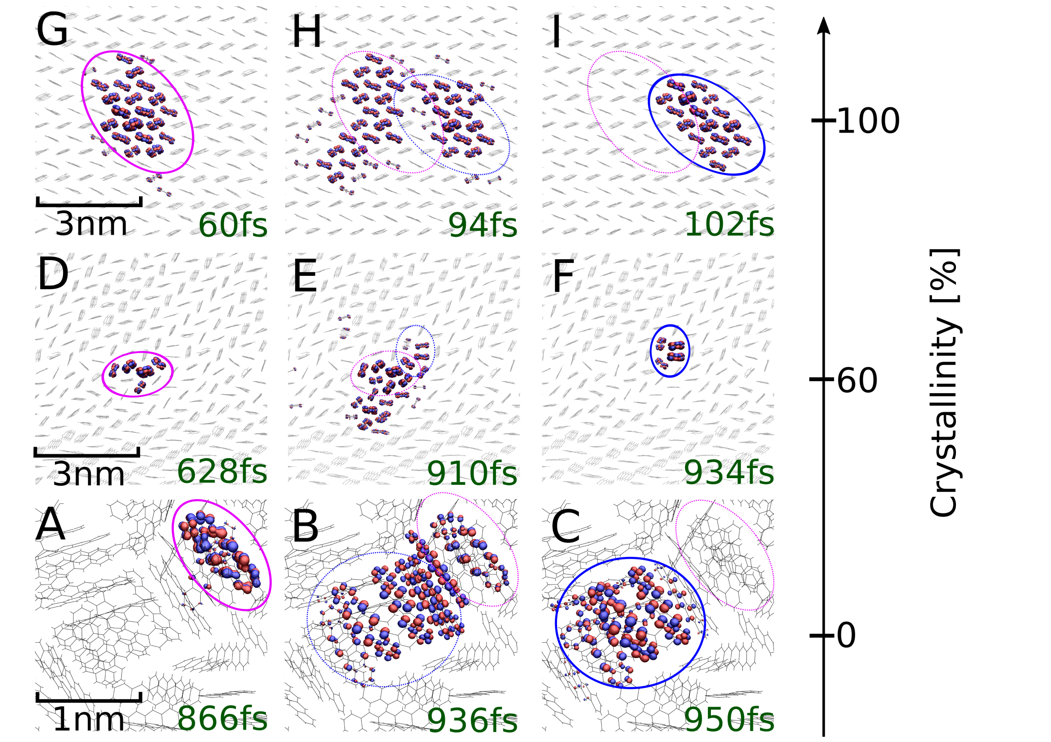
Quantum Delocalisation

Slide 11
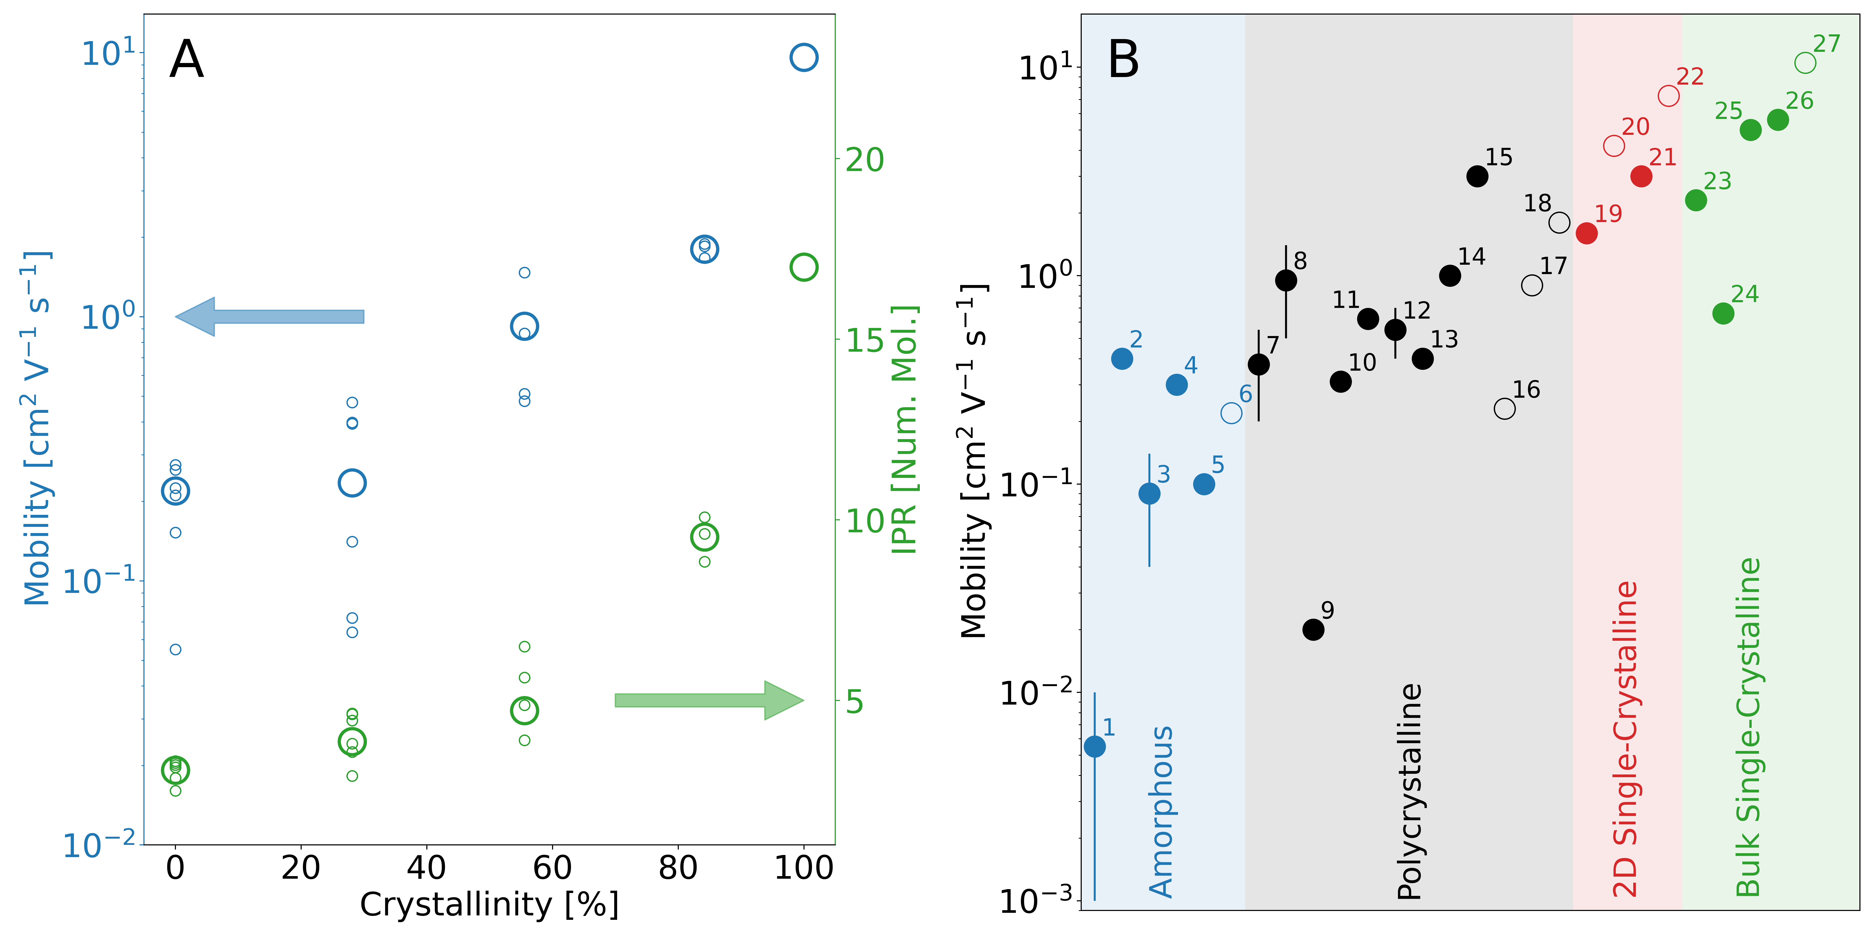
Hole Mobilities

Slide 12
Conclusions from the study
Mobility increases as crystallinity/order increases.
Quantum delocalisation increases with crystallinity.
Would probably see increased trapping/decreased mobility if I also used electrostatics.
Should implement an efficient method for calculating electrostatics.

Slide 13
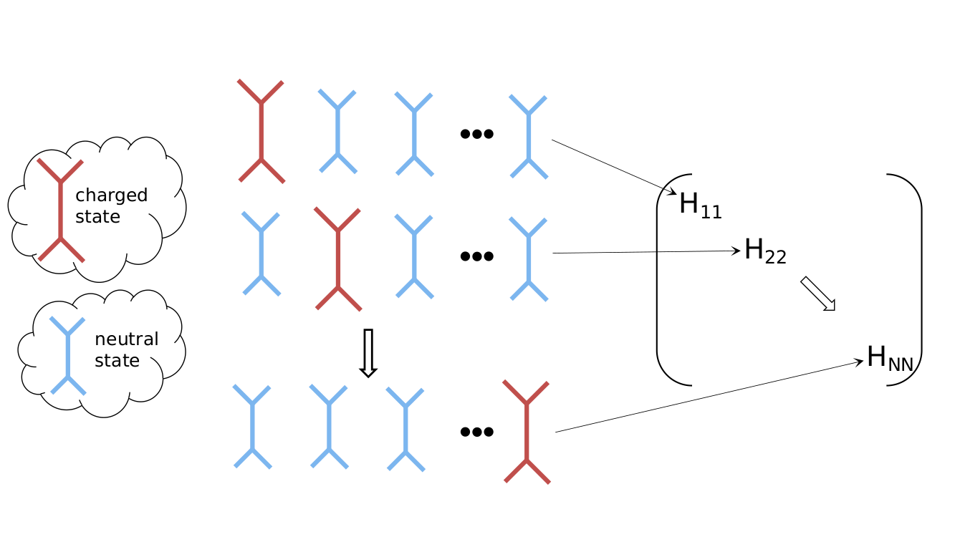
Implementation of (efficient) Electrostatics in Surface hopping
For each site-energy (and diagonal force) the energy (force) of the system with 1 molecule in its charged state and all others neutral should be calculated.

Slide 14
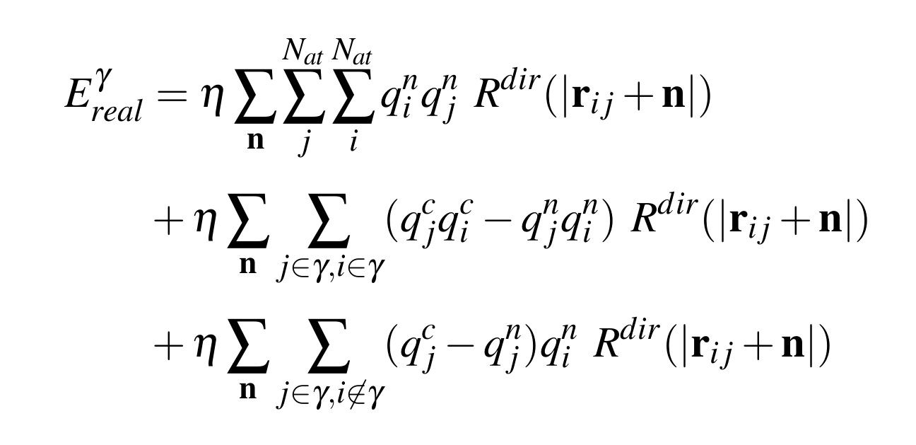
Addition-subtraction scheme (real space energy)
Calculate once and save
Calculate N_{state} times
gamma charged mol index
i, j atom indices
q_{i}^{c(n)} charged (neutral) state charge on atom i
R^{dir}(|r_{ij} + n |) Real space term e.g. erfc(a.|r_{ij} + n |)/|r_{ij} + n | * cutoff

Slide 15
Ewald problem introducing DSF as a solution.
Using Ewald ES, the reciprocal forces cannot be optimised with addition-subtraction
Can use DSF instead.
DSF relies on the observation that the coulomb sum converges quickly if the charges within the cutoff sphere are net-neutral.
To ensure this, image charges are placed on the surface of the cutoff sphere to neutralise the system within a cutoff.
R_{c}

Slide 16
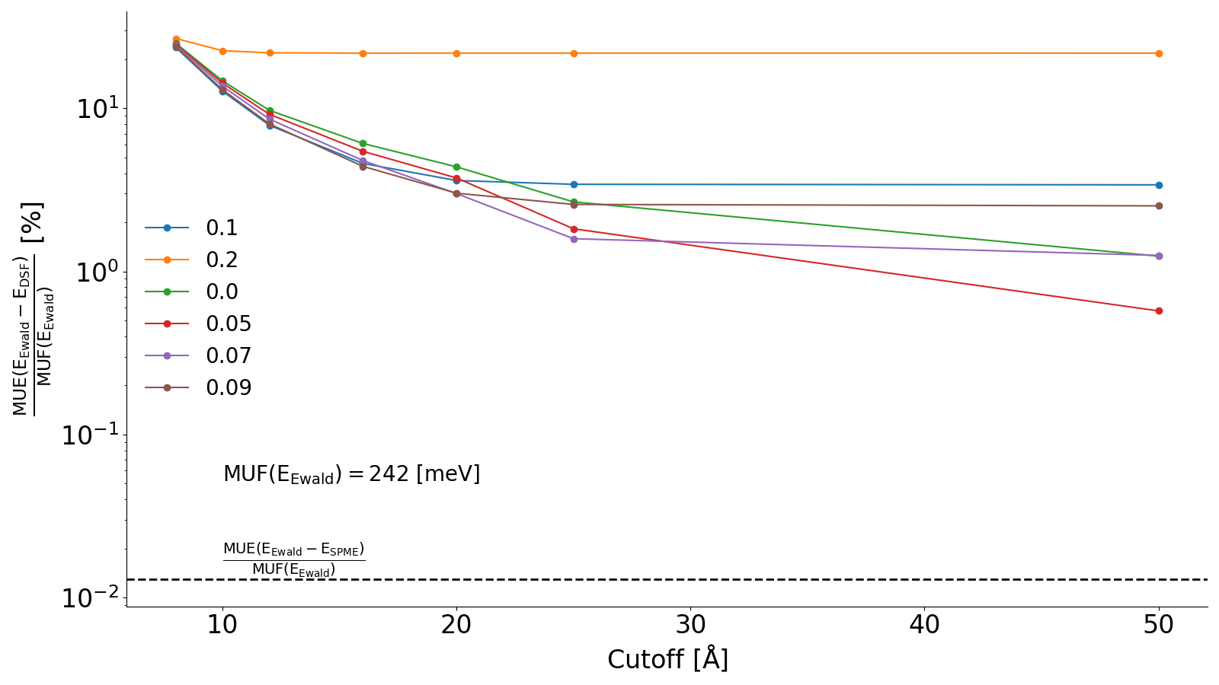
DSF
Use image charges to neutralise charges within a cutoff sphere.
Shift forces and energies to prevent discontinuities at the cutoff radius.

Slide 17
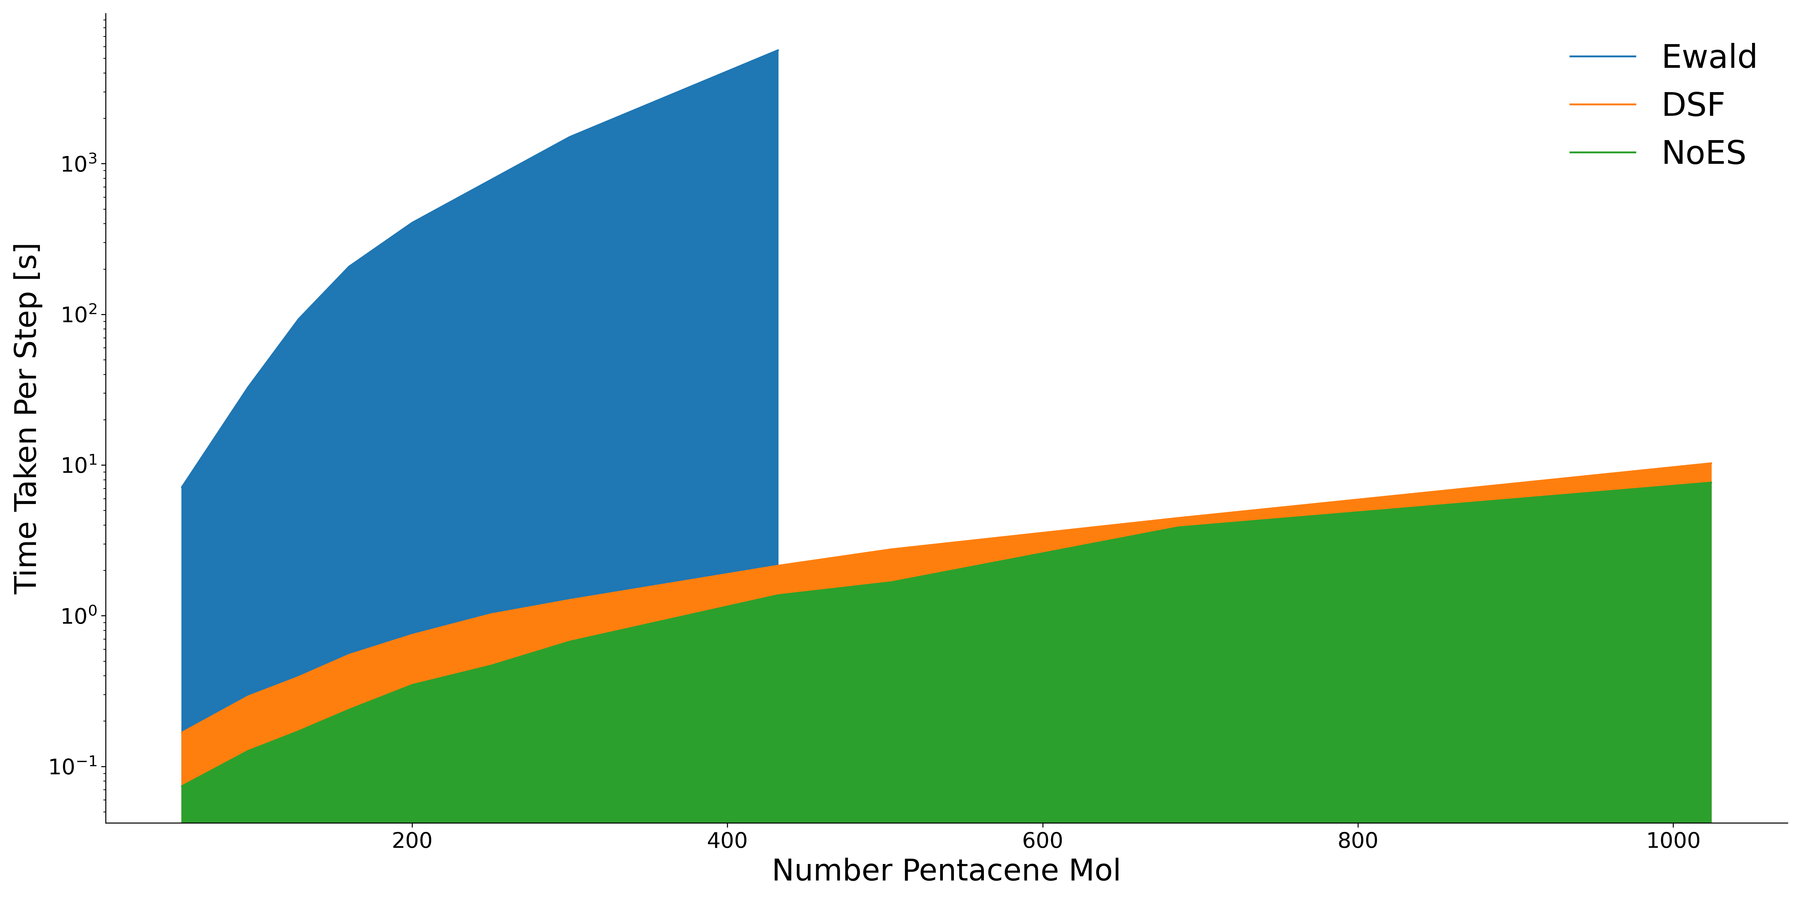
Timings

Slide 18
Conclusions and further work
CTMQC has a number of problems that must be overcome before it is a useful technique in nonadiabatic MD.
To fix these problems perhaps a re-derivation with a different way to construct the nuclear wavefunction should be looked into.
FOB-SH has been shown to be a powerful technique that can be used to study large systems with varying levels of order. Efficient electrostatics can now be used in simulations
The amorphous systems should now be re-simulated with electrostatics turned on to see if the increased trapping is observed and as an initial, real-world, test of the DSF implementation.

